Slide 1



BD25_Project_F4_B
Real-Time Traffic Monitoring
Final Presentation
Big Data PBL (SoSe25)
18.06.2025
Presented by:
Gayathri Shiburaj, Manali Suhas Bansode, Ravi Raj, Shinu Shaju

Slide 2




Meet the Team
Gayathri Shiburaj
Manali
Suhas Bansode
Ravi
Raj
Shinu
Shaju
2
Notes:
‹#›

Slide 3
Project Goal & Objectives
Build a real-time, scalable system to monitor 10,000+ taxis live in Beijing using taxi GPS trajectory data
Process high-throughput, continuous data streams with low latency
Compute taxi speed, average speed, distance run, and violation alerts in real-time
Present actionable insights live on a responsive dashboard for large-scale taxi fleet monitoring
Design for scalability, fault tolerance, and future extensibility
3
Notes:
‹#›

Slide 4
Dataset Overview
T-Drive Trajectory Dataset (Microsoft Research), Beijing, 2008
10,357 taxis, ~17M taxi GPS data points over 7 days, ~9M total distance run
Features: taxi_id, timestamp, latitude, longitude
Provides high-frequency taxi updates to enable controlled real-time data ingestion
Serves as a reliable ground truth for urban mobility systems under realistic conditions
4
Notes:
‹#›

Slide 5
Key Challenges
High Throughput: Processing 17M+ GPS points from 10000+ taxis with a goal of lowest latency possible
Data Quality: Handling invalid and null data gracefully without disrupting pipeline flow or compromising data quality
Real-Time Guarantees: Deliver continuous, low-latency insights to end-users without delays
State Management: Tracking each taxi’s prior location data for computing speed, distance, and speed and gefence violations incidents
Scalability vs. Accuracy: Balancing resources while maintaining stability and correctness under load
Fault Tolerance: Recover reliably and quickly from failures without any data loss
5
Notes:
‹#›

Slide 6
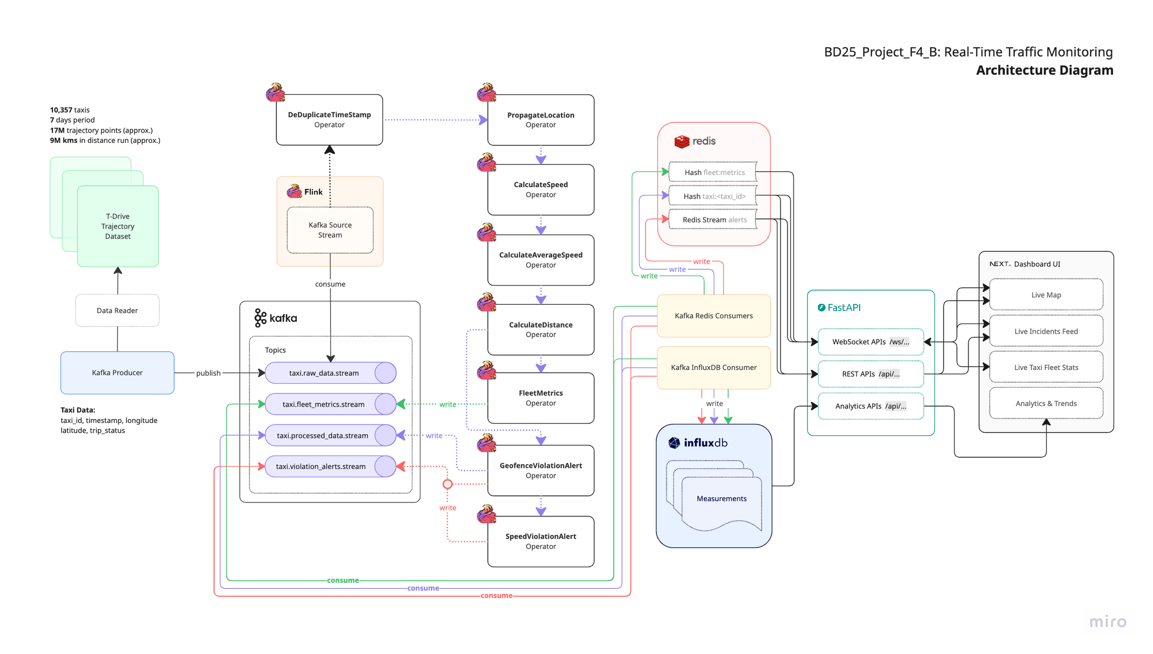
System Architecture
6
Notes:
‹#›

Slide 7
System Architecture
DataReader:
Adds a trip_status field (active/end) to a taxi message
Sorts records by timestamp for event-time correctness
Serializes entire data as fast-loading pickle file
Supports dataset size limit for controlled testing
Apache Kafka Producer:
Supports high-throughput data streaming to match pipeline capacity
Two data replay modes (actual event delays, simulated 1s)
Data ingestion speed controls (1x–3x)
Batches all records with same timestamp for efficiency
Kafka Broker:
Deployed in KRaft mode (1 broker)
Automated creation of Kafka topics with docker init container
Web UI for monitoring
7
Notes:
‹#›

Slide 8
System Architecture
Apache Flink DataStream Pipeline & Operators:
Built and deployed a custom Docker image to support PyFlink DataStream APIs for efficient pipeline execution
1 x JobManager, 1 x TaskManager (parallelism = 1, task slots = 1)
Docker init container to automate flink job creation & execution
Kafka source connector creates datastream from source topic
Source stream undergoes transformations by sequential operators
Kafka sink connector sinks datastreams to target topics
Event-time processing with monotonic watermarks
Embedded RocksDB for state backend
Incremental checkpointing for fault tolerance
Web UI for monitoring and debugging
8
Notes:
‹#›

Slide 9
System Architecture
Kafka Consumers:
Redis:
Redis Hash for caching taxi data and fleet metrics
Redis Streams for storing taxi violation alerts
InfluxDB:
Uses InfluxDB Measurements for storing taxi data, fleet metrics and violation alerts for analytics
FastAPI Backend APIs:
REST + WebSocket APIs for live & historical taxi data, violation alerts and analytics
NextJS Dashboard UI:
Interactive map with Leaflet + clustering for scalable, responsive taxi tracking under load
Live and historical incidents feed for speed and geofence violation alerts
Taxi fleet-level and per-taxi metrics and analytics
9
Notes:
‹#›

Slide 10
Initial DataStream Pipeline Performance Challenges
High and increasing latency, hindering real-time responsiveness
Persistent operator tasks backpressure and growing consumer lag under high load
Unbounded state & timer growth in operators, increasing memory, resource usage and latency
Performance degraded under load beyond 3,000 taxis due to throughput limits
Unable to achieve low and stable latency while scaling to 9,000+ taxis
10
Notes:
‹#›

Slide 11
DataStream Pipeline Optimization Strategies
PropagateLocation Logic: Replaced timers with timestamp-based emission to prevent backpressure
Monotonic Watermarks: Reduced latency by avoiding out-of-order and late arrival waits
DataStream Serialization & Deserialization: Parsed Kafka JSON messages once at the Kafka source to a structured data, avoiding repeated serialization/deserialization in downstream operators
Fast Serialization: Switched to orjson instead of standard json for faster, low-CPU serialization
EmbeddedRocksDB State Backend: Enabled scalable, disk-backed state with incremental checkpoints
TaskManager Memory Tuning: Increased managed memory, tuned network buffers for load
Frequent Checkpointing: Incremental checkpoints (every 1s) for fast recovery with minimal overhead
State Cleanup: Cleared trip ended taxis state in operators to prevent state bloat
Early Propagation: Moved PropagateLocation operator to pipeline start to reduce downstream load
11
Notes:
‹#›

Slide 12
Performance Test: Setup and Benchmarking
Benchmarking Measurements:
Event Latency: Time from message ingestion to Kafka source topic (T1) to processing and sinking datastream to Kafka target topics (T2)
Pipeline Throughput: messages processed per second (40 msgs/s)
Load simulation: Variable taxi count over time (upto 10,000+ simultaneous taxis).
Performance Test Environment & Configurations:
Hardware Specifications: 4 vCPU, 16GB RAM, 50GB SSD
Kafka and Flink Configuration: parallelism = 1, partitions = 1, task slots = 1
Data Replay Configuration: simulated mode at 1x speed, max 10,357 taxis
Data Volume: 400,000 messages processed over a 2-hour runtime
Custom Benchmarking Tool: Developed a custom benchmarking tool to measure key metrics such as event latency vs load, event latency per message, and throughput vs event latency graphs
12
Notes:
‹#›

Slide 13
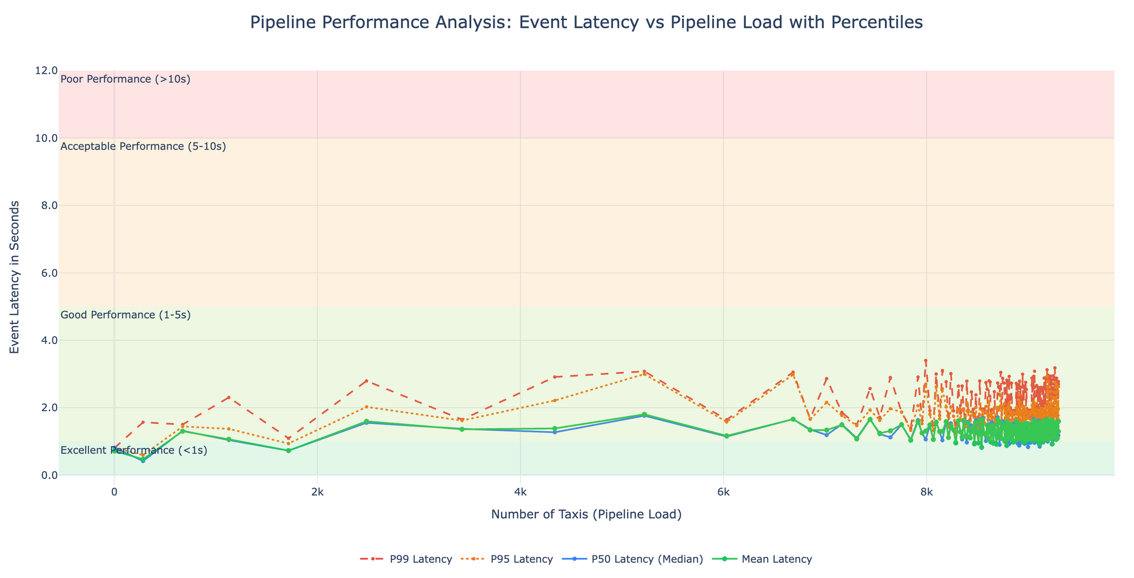
Performance Test: Results and Analysis
13
Notes:
‹#›

Slide 14
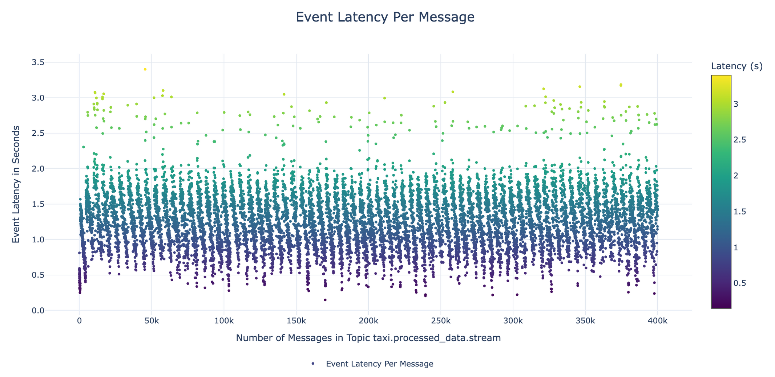
Performance Test: Results and Analysis
14
Notes:
‹#›

Slide 15
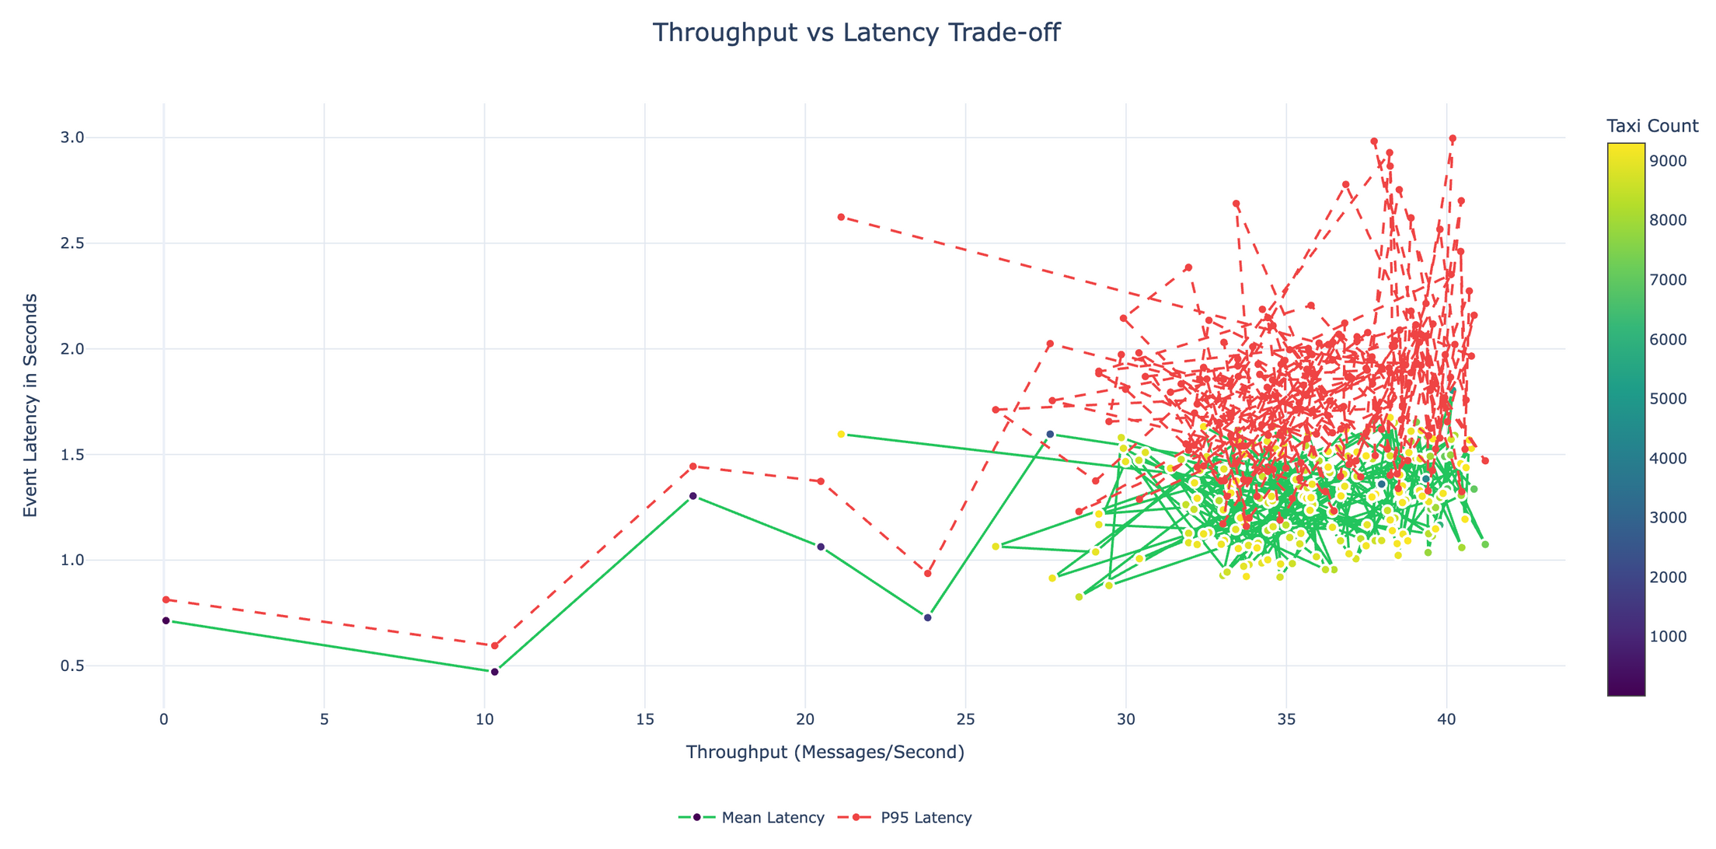
Performance Test: Results and Analysis
15
Notes:
‹#›

Slide 16
Performance Test: Key Insights
Consistent Low Latency: Processes 95% of messages within 2 seconds across all loads
Predictable Latency Growth: Stable latency increase from low to higher test loads
Resilience: Minor latency spikes at peak load, but quickly recover
Throughput-Latency Balance: Efficiently handles medium to high workloads
No Backpressure: Operators run with low utilization and smooth data flow
Fast Checkpointing: Incremental RocksDB checkpoints complete in <1s
Stable Performance: Achieves stable performance with simple pipeline setup
Scalable Real-Time Monitoring: Supports reliable taxi fleet monitoring at scale
16
Notes:
‹#›

Slide 17
Extended Load Testing & Future Scaling
Extended Load Test: At 3X replay speed (~120 msgs/s, 10,357 taxis), latency spiked sharply (60–250s) before stabilizing, indicating natural saturation near system capacity
Resilience Under High Load: Longer busy periods and occasional backpressure observed for operator tasks, but the pipeline recovered quickly and remained stable
Scaling checklist for higher throughput with low latency:
TaskManager Scaling: Increase TaskManager count and memory
Increase Kafka Partitioning: Use multi-partition topics for better load distribution
Increase Parallelism & Task Slots: Adjust operator parallelism and task slot allocation
State Backend Optimization: Tune RocksDB and checkpoint settings for high throughput
Auto-Scaling: Enable Flink dynamic scaling based on ingestion rates
Dedicated VM Deployment: Run high-load services on dedicated VMs for isolation and efficiency
17
Notes:
‹#›

Slide 18
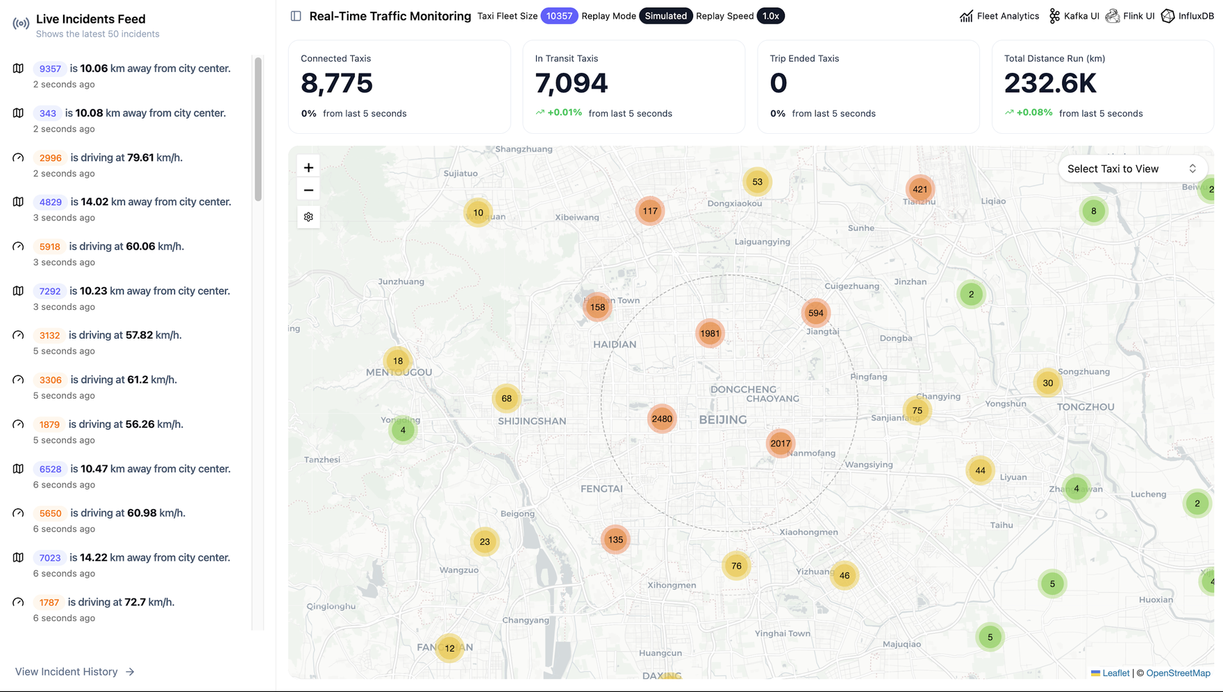
Dashboard Key Features: Live Fleet Monitoring
18
Notes:
‹#›

Slide 19
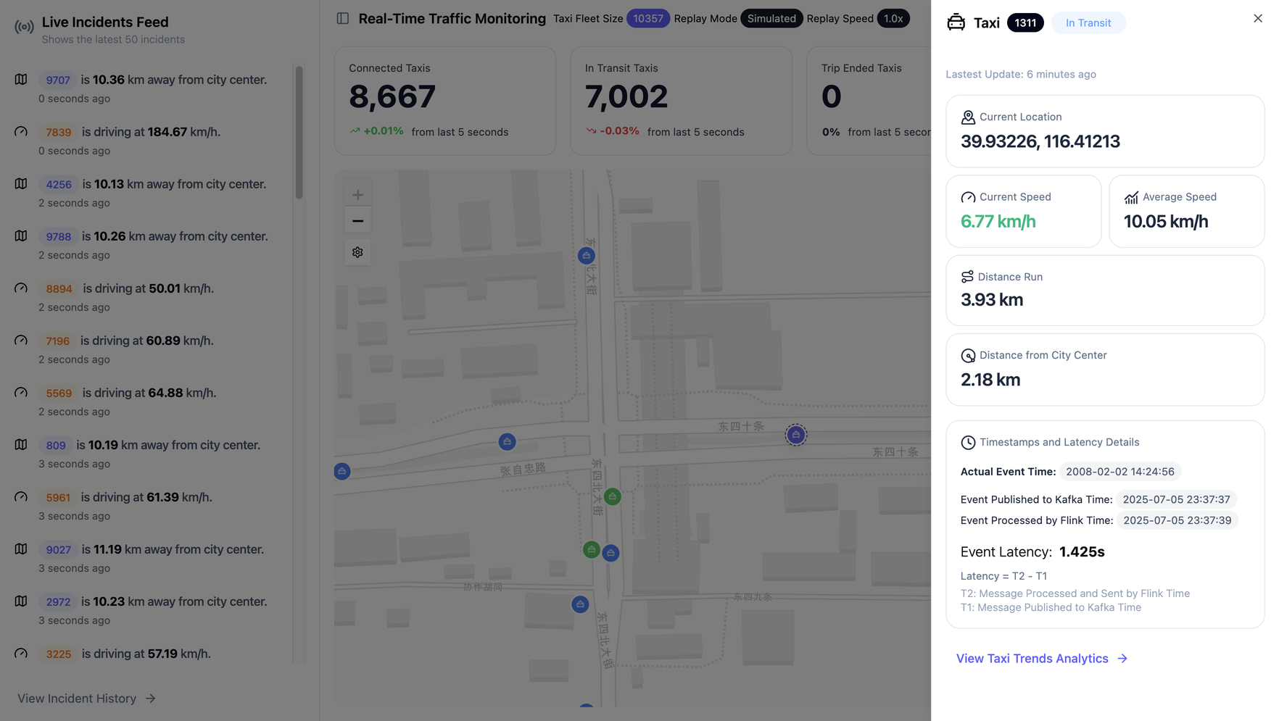
Dashboard Key Features: Per-Taxi Monitoring
19
Notes:
‹#›

Slide 20
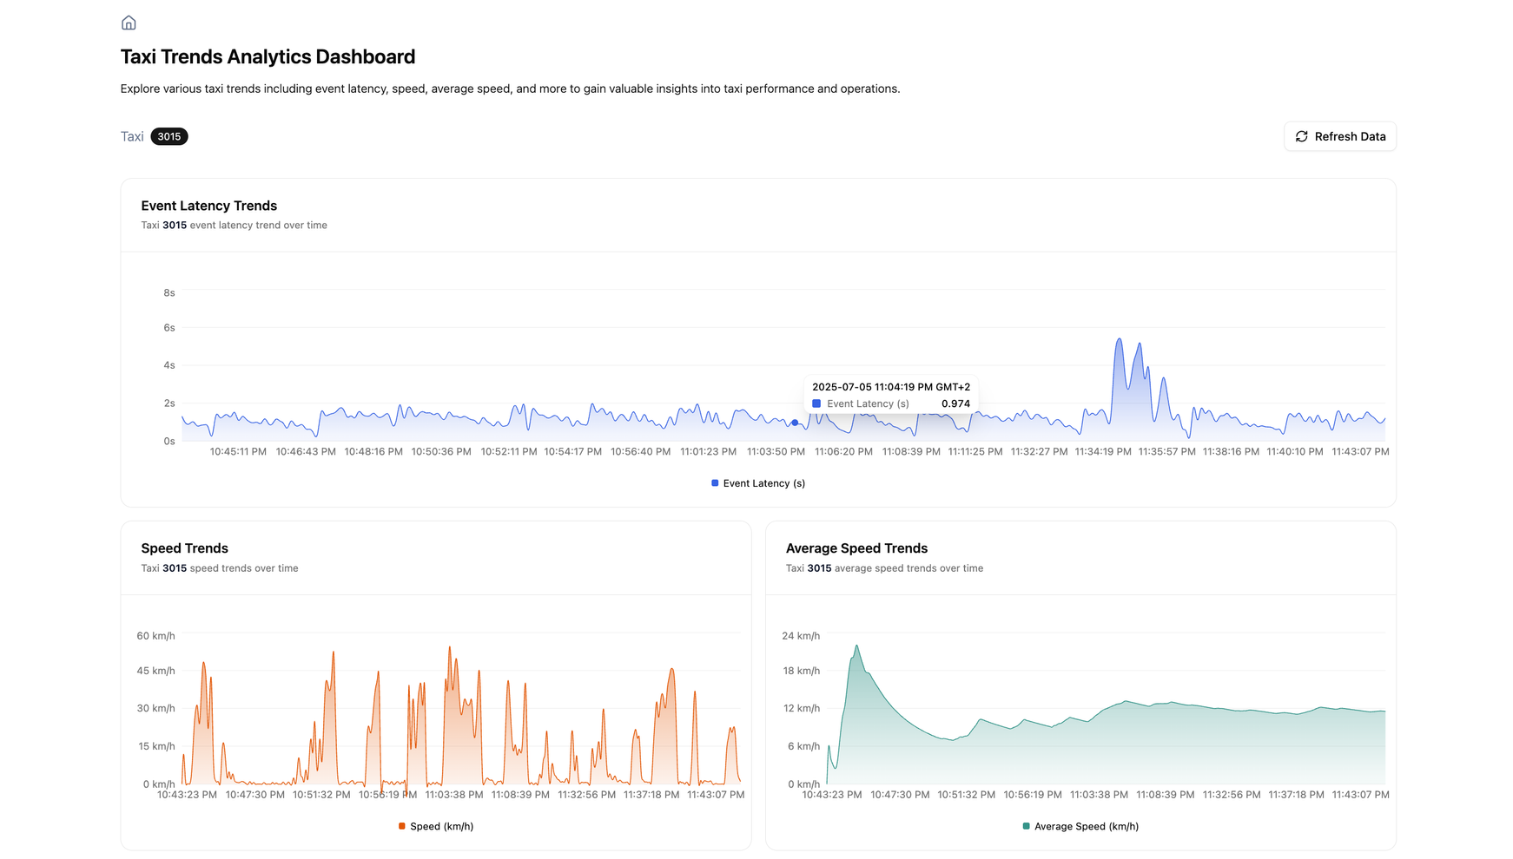
Dashboard Key Features: Per-Taxi Analytics
20
Notes:
‹#›

Slide 21
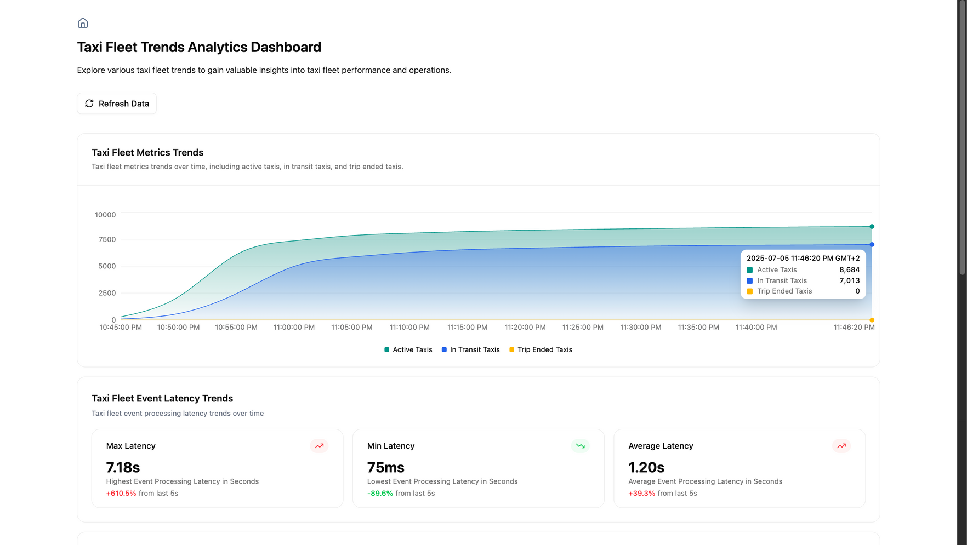
Dashboard Key Features: Taxi Fleet Analytics
21
Notes:
‹#›

Slide 22
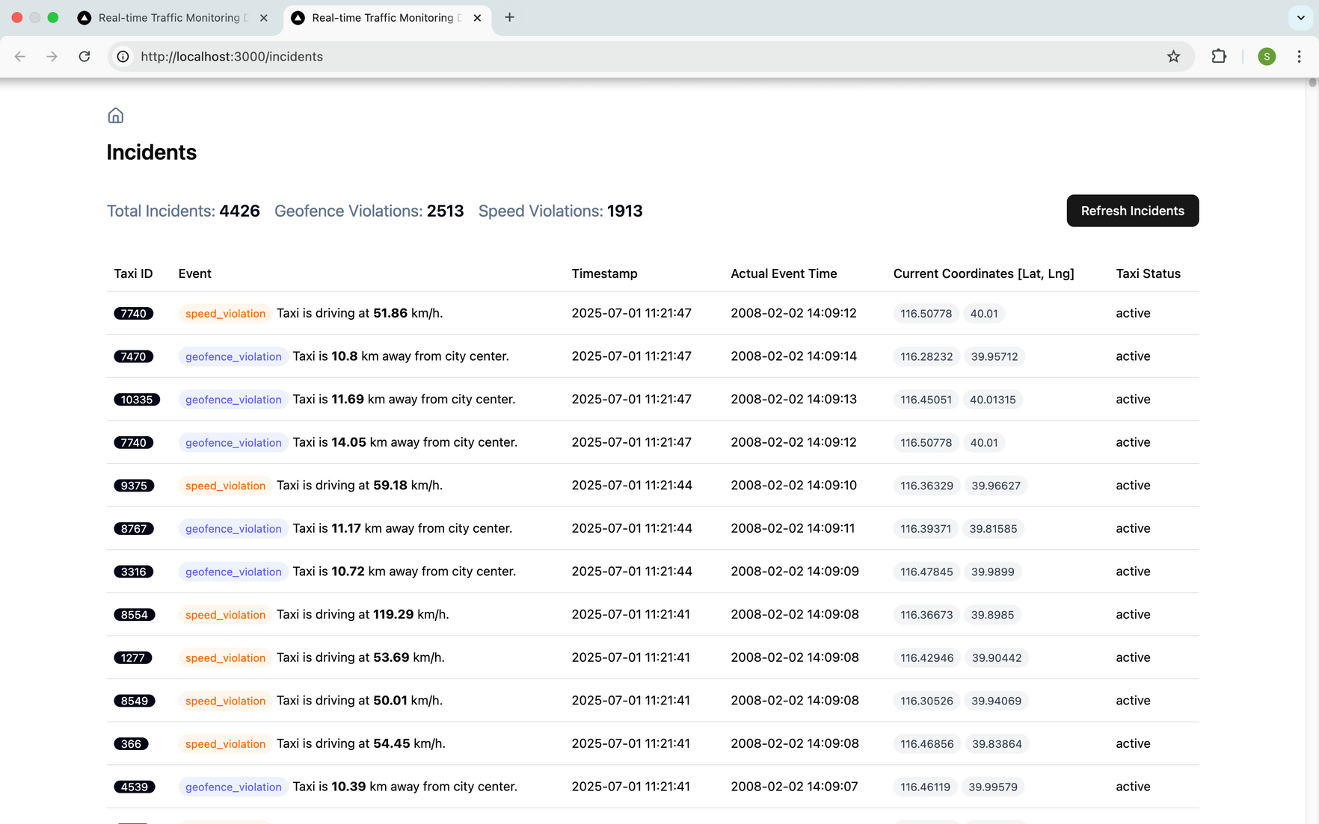
Dashboard Key Features: Incidents History
22
Notes:
‹#›

Slide 23
Live Demo
Let’s see it live... 🚀
23
Notes:
‹#›

Slide 24
Conclusion & Key Achievements
Transformed slow system into a fast, scalable real-time taxi fleet monitoring platform
Reduced average event processing time from ~35s or higher to <2s per message
Supports 9,000+ taxis simultaneously without performance degradation
95% of messages processed within 2s across all load levels
Smooth pipeline operation with no bottlenecks under heavy load
Fast RocksDB checkpointing (<1s) ensures quick failure recovery
Improvements are driven by optimized state management, memory tuning, and operator design
System is reliable and ready for real-time taxi fleet traffic monitoring systems
24
Notes:
‹#›

Slide 25

Questions?
Thank You!
tuhh.de

